Slide 1
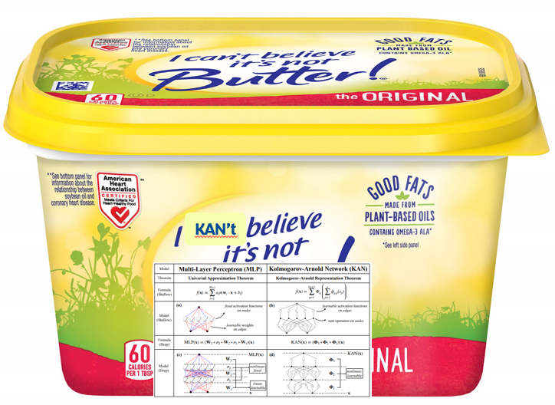

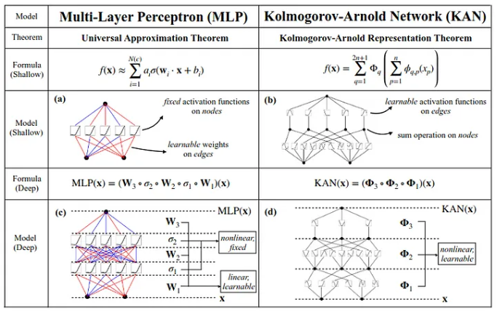
I KAN't Believe It's Not Neural Nets! Kolmogorov-Arnold Networks Applications, Limitations, and Discussion
Image cropped by TJ LaGrow with memed butter
Khan made famous by a Shatner Scream
Presentation by TJ LaGrow
TReNDS Center MLBBQ
9/27/2024
KAN: Kolmogorov–Arnold Networks by Liu et. al.: https://arxiv.org/pdf/2404.19756
Notes:
Big paper by Microsoft after they invested 10BB in OpenAI. This is one for their big

Slide 2
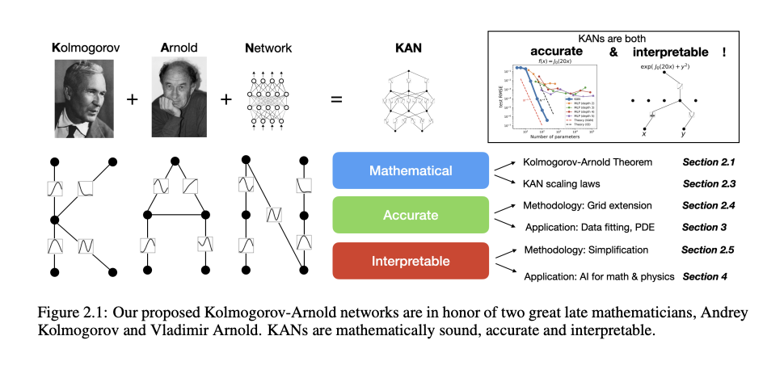
Overview
Background
Mathematical Section Paper
Accurate Section of Paper
Interpretable Section of Paper
Limitations
Further Applications
Discussion

Slide 3
Background

Slide 4
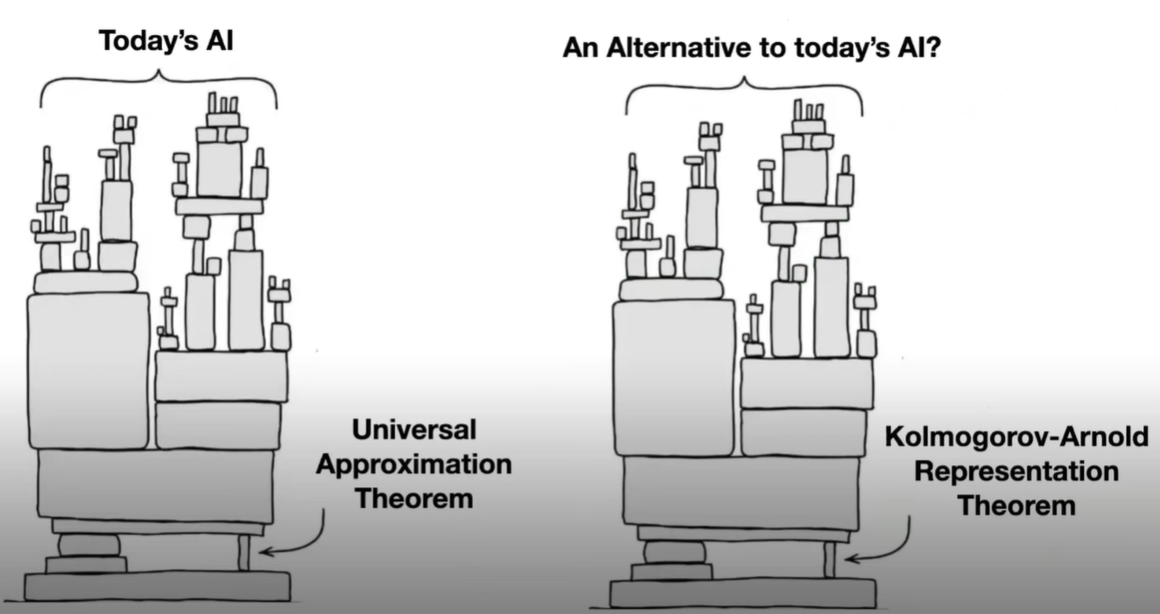
Background
Google Talk with Liu on same paper: https://www.youtube.com/watch?v=JuPwfQlPUt0&ab_channel=GoogleTechTalks

Slide 5
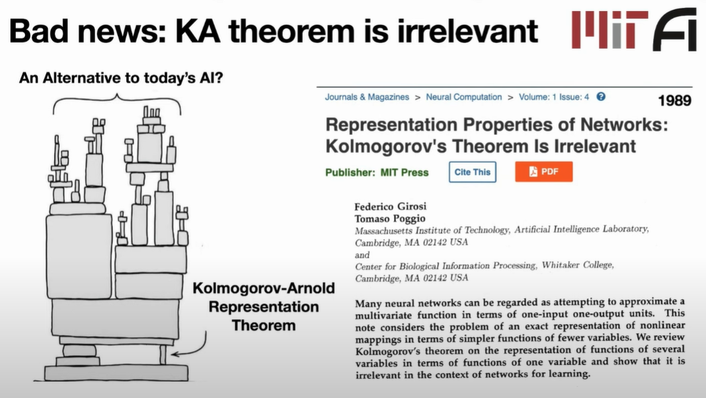
Background
Google Talk with Liu on same paper: https://www.youtube.com/watch?v=JuPwfQlPUt0&ab_channel=GoogleTechTalks

Slide 6
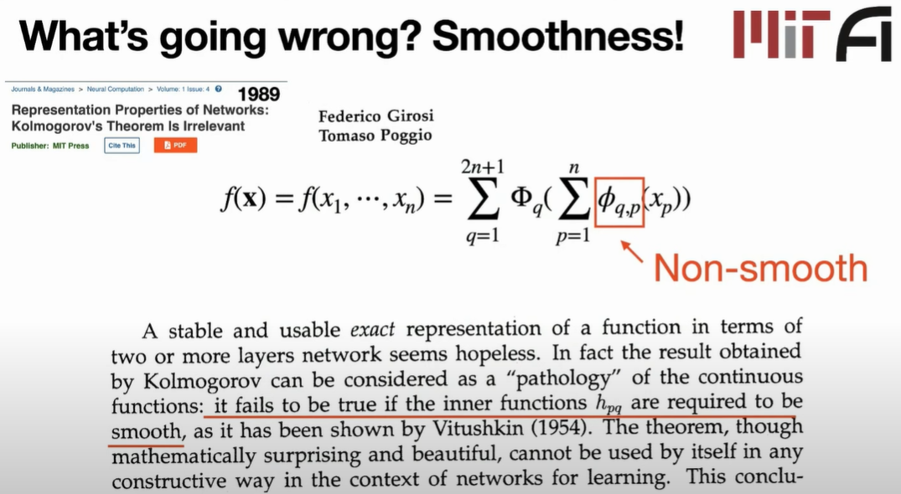
Background
Google Talk with Liu on same paper: https://www.youtube.com/watch?v=JuPwfQlPUt0&ab_channel=GoogleTechTalks

Slide 7
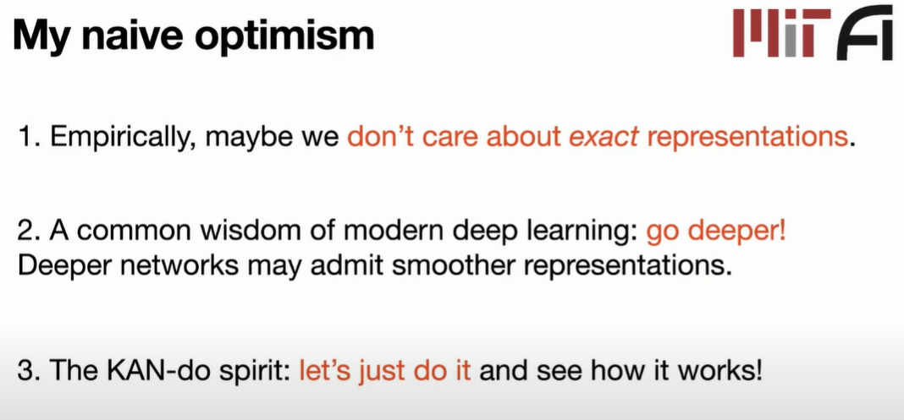
Background
Google Talk with Liu on same paper: https://www.youtube.com/watch?v=JuPwfQlPUt0&ab_channel=GoogleTechTalks

Slide 8
Background

Slide 9
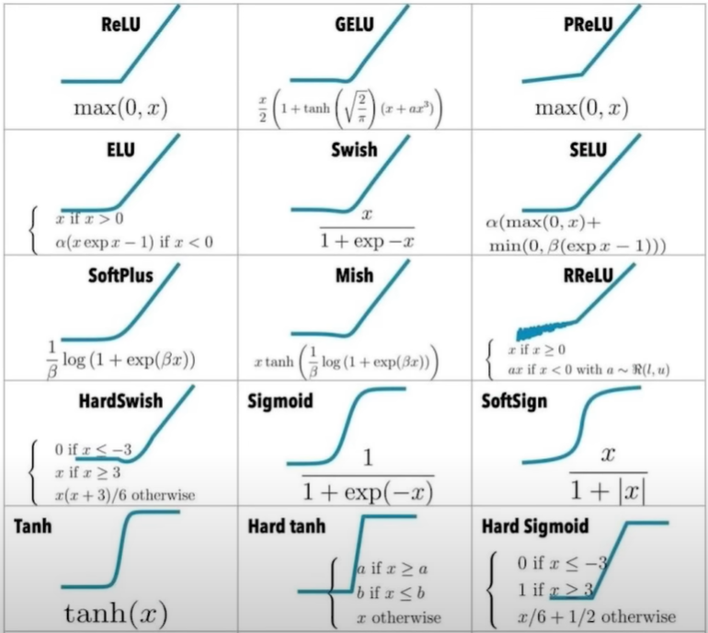
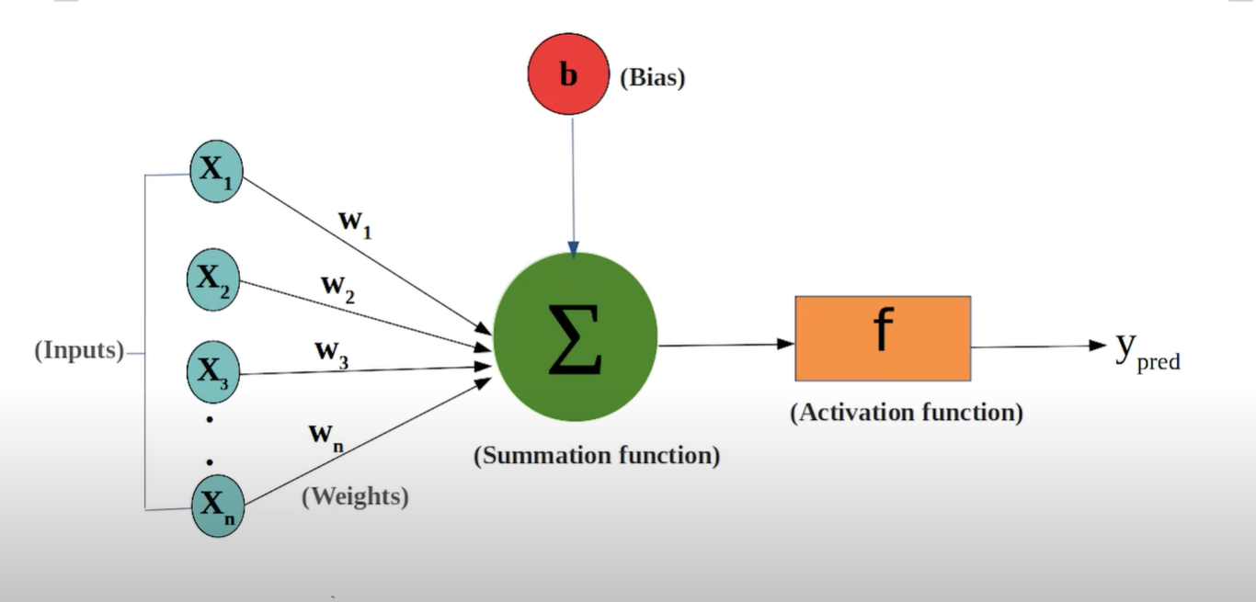
Background
MLPs
Bycloud video on youtube: https://www.youtube.com/watch?v=xLnQtLpPH-Y&t=536s&ab_channel=bycloud

Slide 10
Background
MLPs:
Activation functions in MLPs are pre-defined and non-linear.
The connections between neurons carry simple weights that are adjusted during training.
KANs:
Instead of using fixed activation functions at each neuron, KANs employ learnable activation functions on the edges themselves.
These activation functions are constructed using basis functions, like B-splines.
By learning the coefficients of these basis functions, KANs can achieve highly flexible and expressive activation functions on each connection.
Notably, KANs completely remove traditional linear weights from the network, with all weight parameters being replaced by the coefficients within the edge’s activation function.

Slide 11
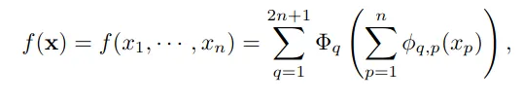
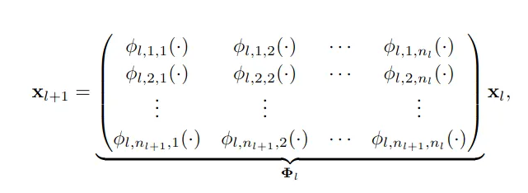
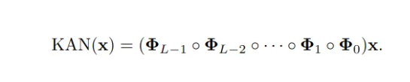
Background
KANs
(1)
(2)
(3)

Slide 12
Background

Slide 13
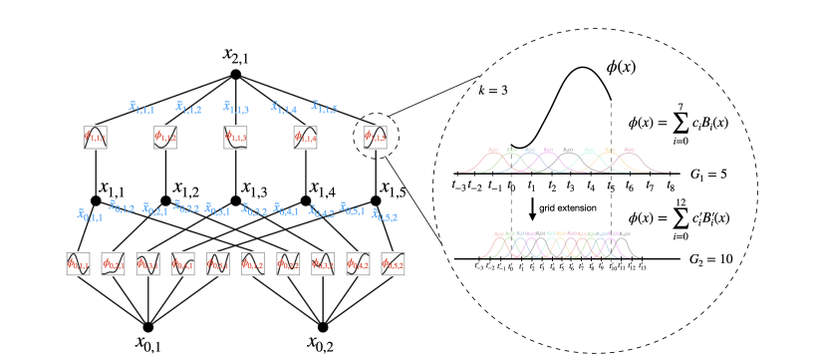
Background
B-Splines

Slide 14
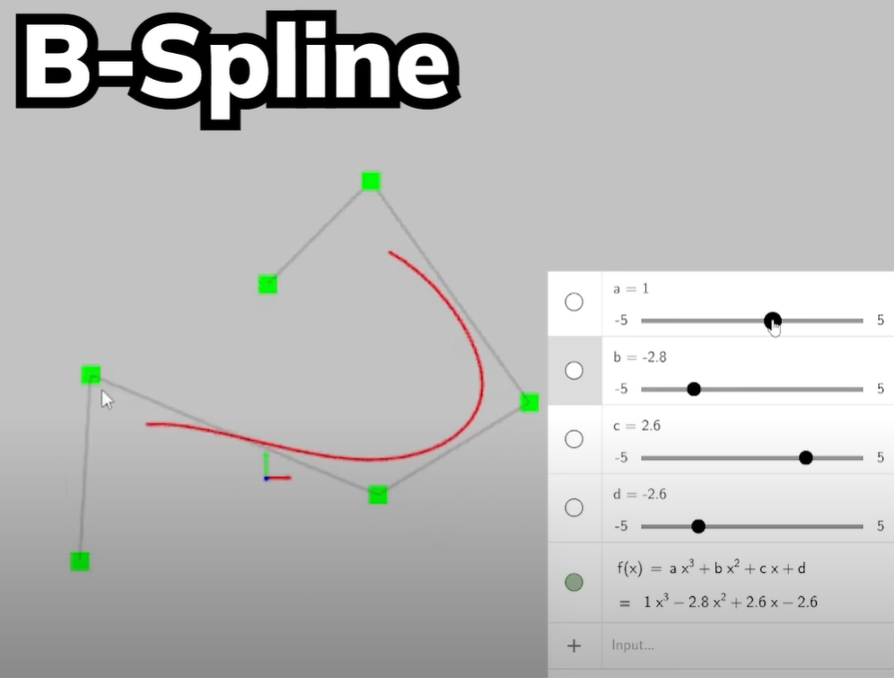
Background
B-Splines

Slide 15
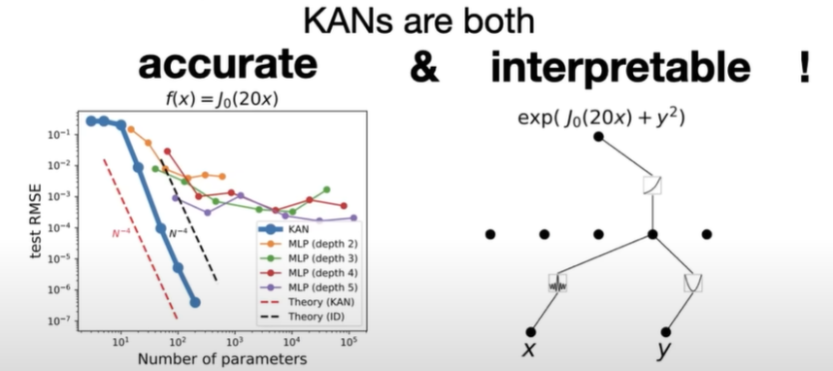
Accuracy & Interpretable

Slide 16
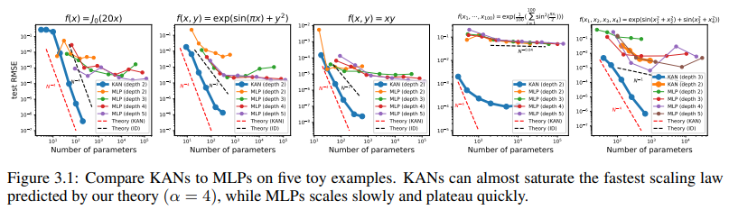
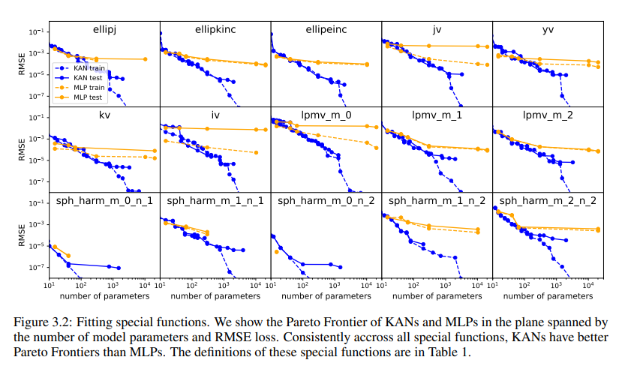
Accuracy

Slide 17
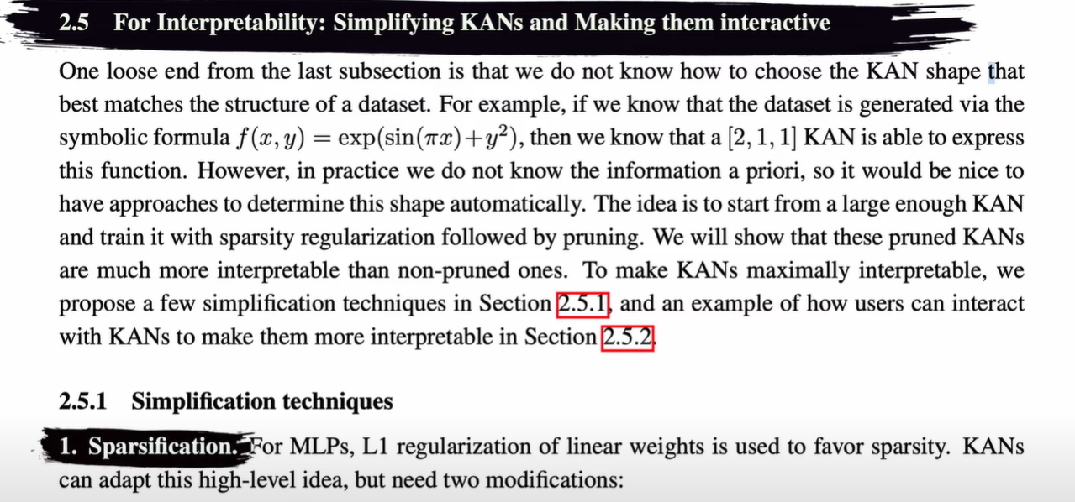
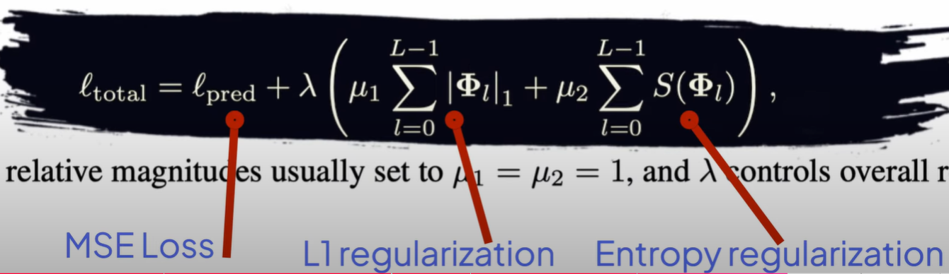
Interpretability
Notes:
Symbolic representation

Slide 18
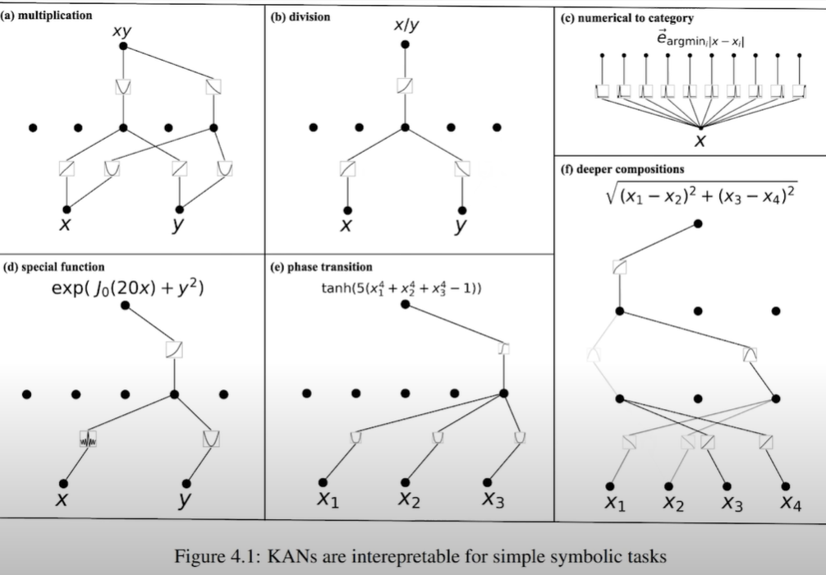
Interpretability

Slide 19
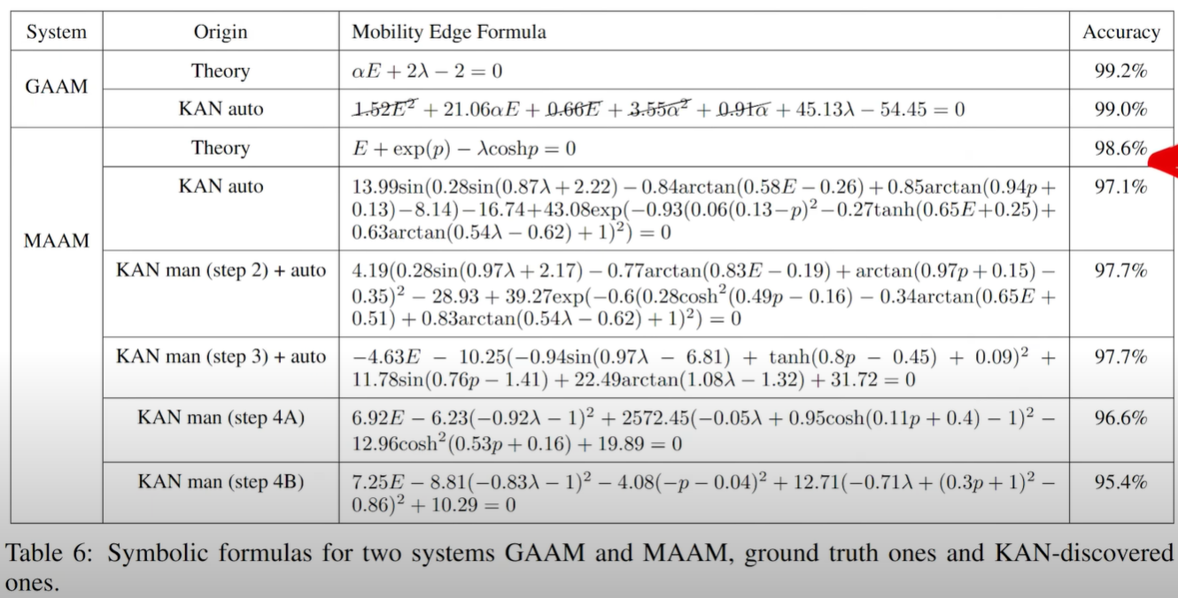
Interpretability
Notes:
Symbolic representation

Slide 20
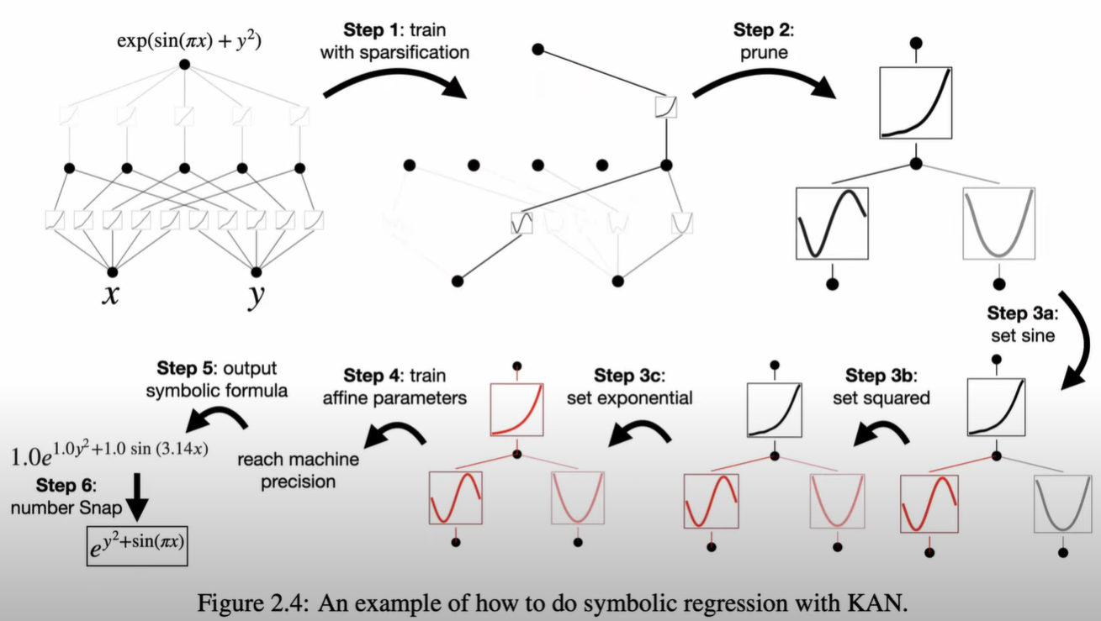
Interpretability

Slide 21
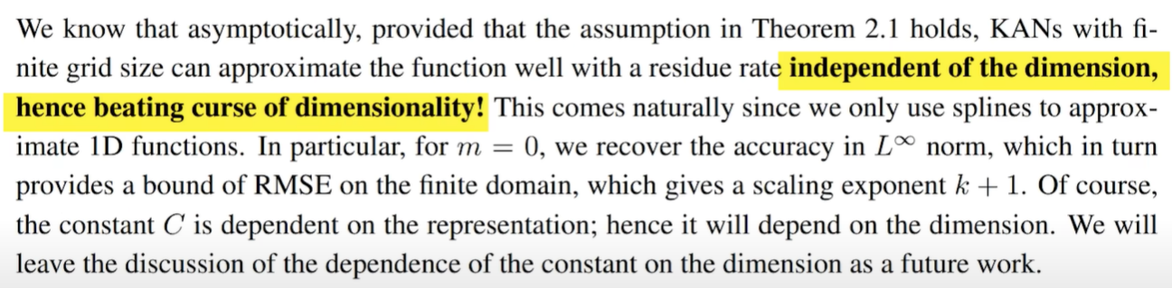
Interpretability
Notes:
Symbolic representation

Slide 22
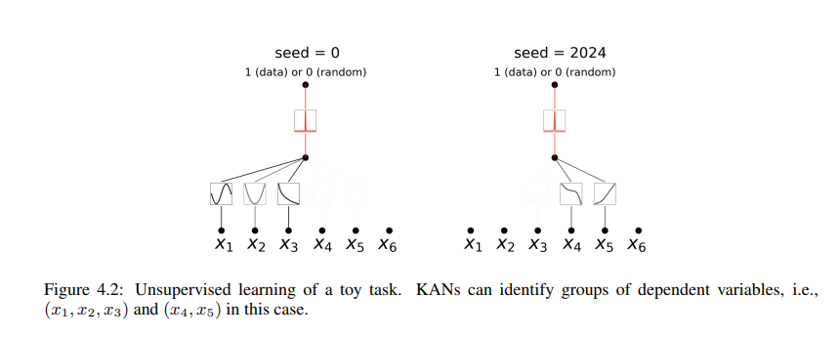
Interpretability
Notes:
Symbolic representation

Slide 23
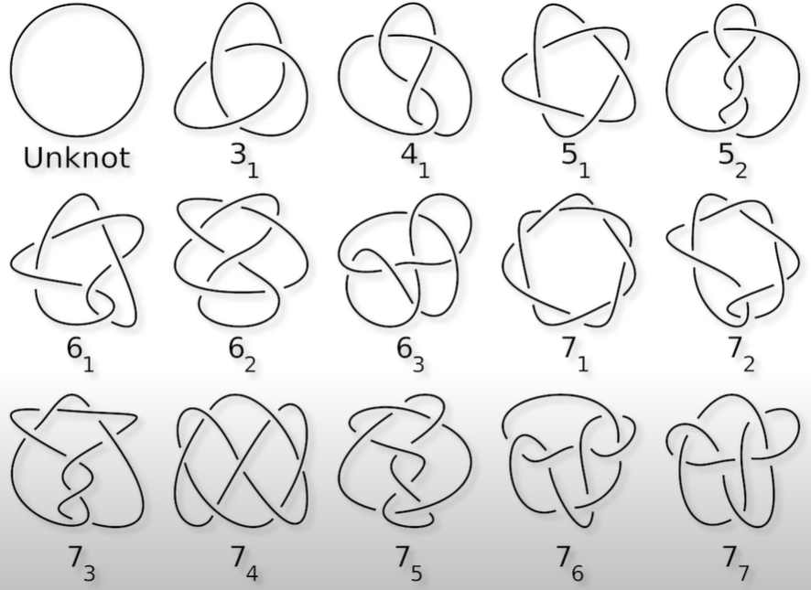
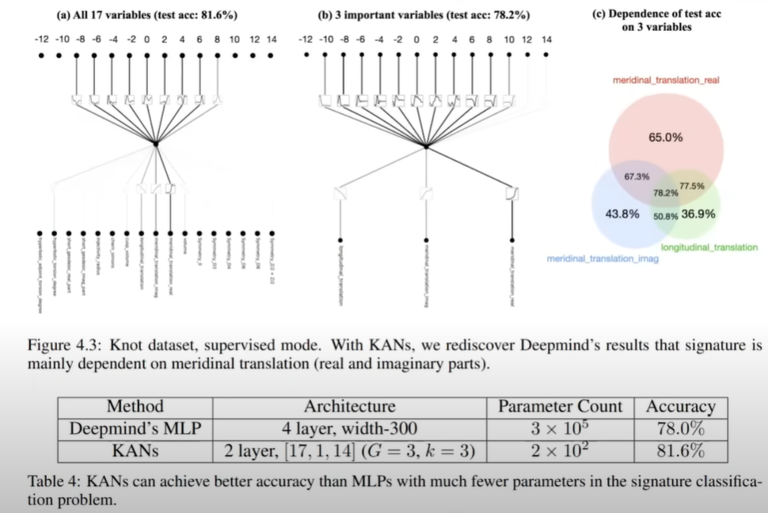
Interpretability
Knots
Notes:
Symbolic representation

Slide 24
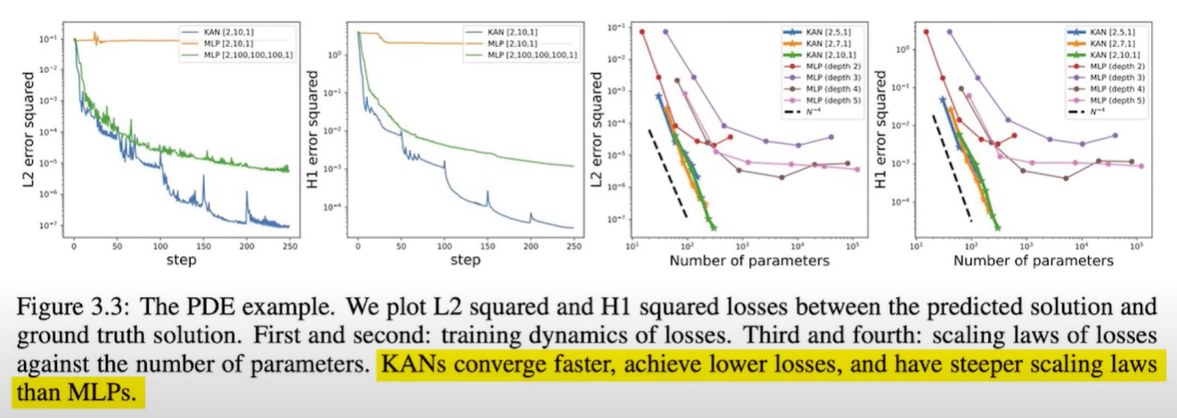
Scaling
Notes:
Symbolic representation

Slide 25
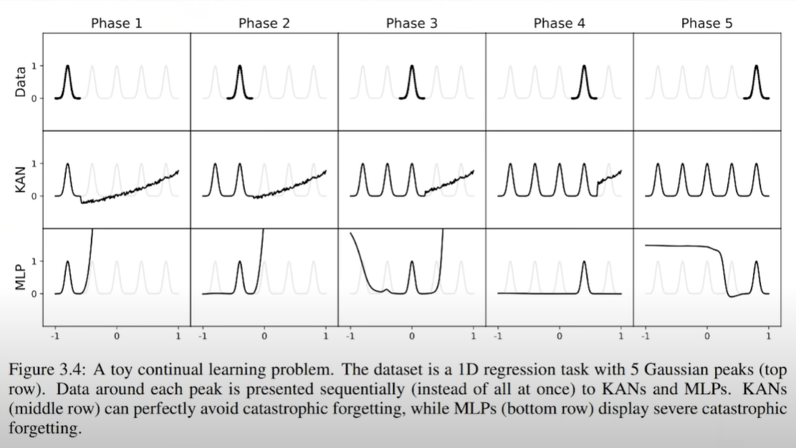
Sequential
Notes:
Symbolic representation

Slide 26
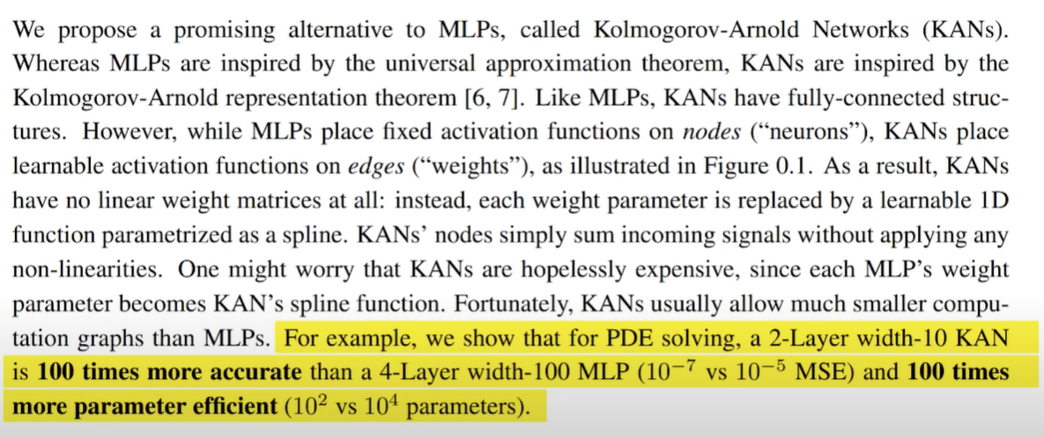
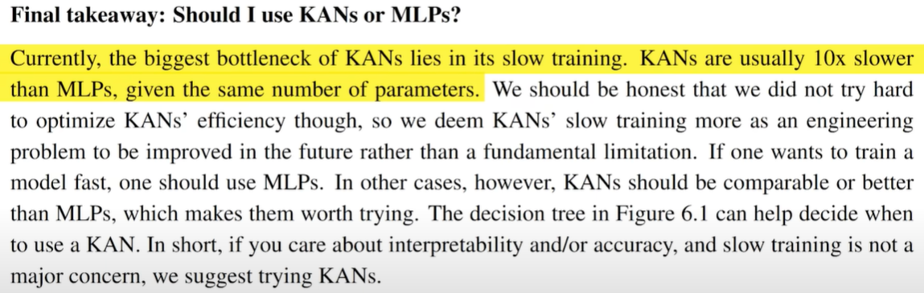
Claims
Notes:
Symbolic representation

Slide 27
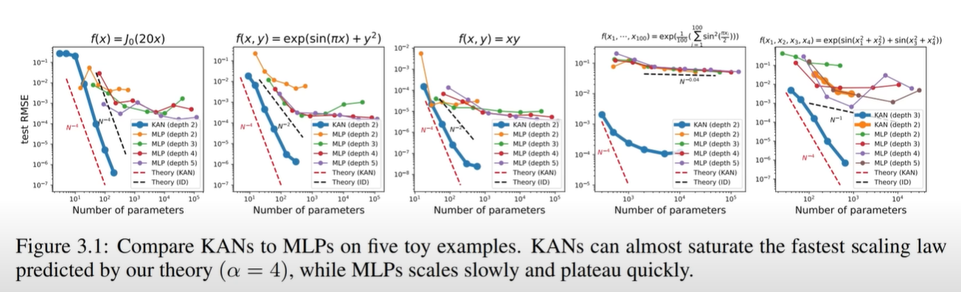
Claims
So… this is around 10x efficiency…?
We can use 10x less vram?
New LLM basis…?
Notes:
Symbolic representation

Slide 28
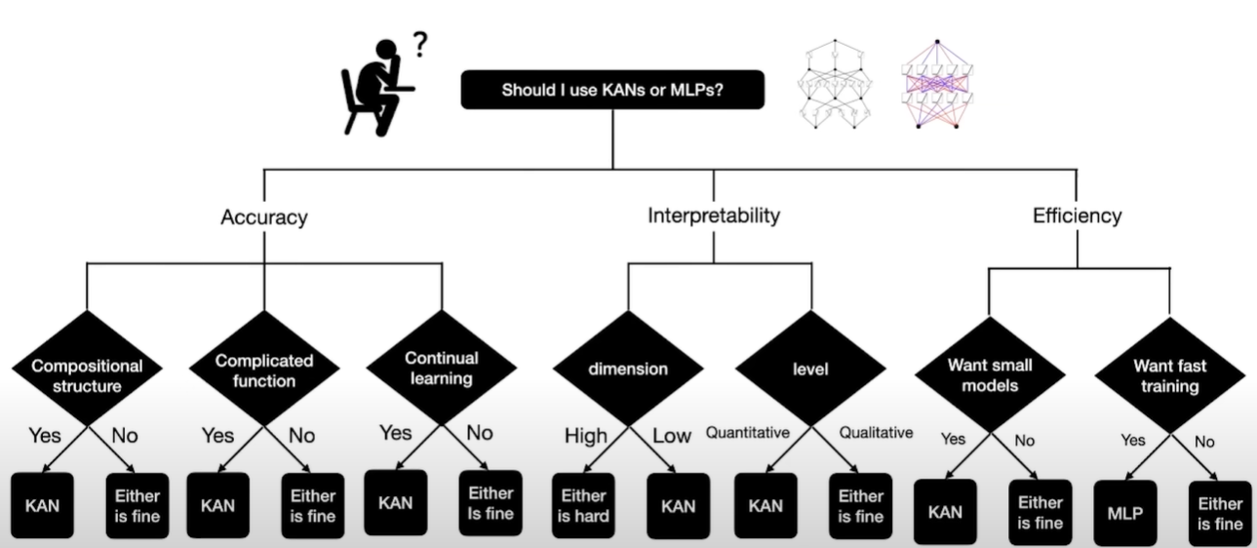
How to Use?
Pykan is an open-source package!
Notes:
Symbolic representation

Slide 29
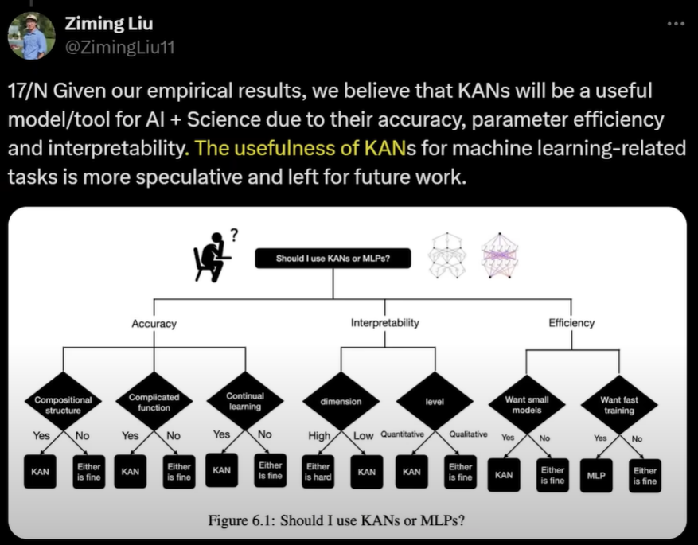
How to Use?
Pykan is an open-source package!
Notes:
Symbolic representation

Slide 30
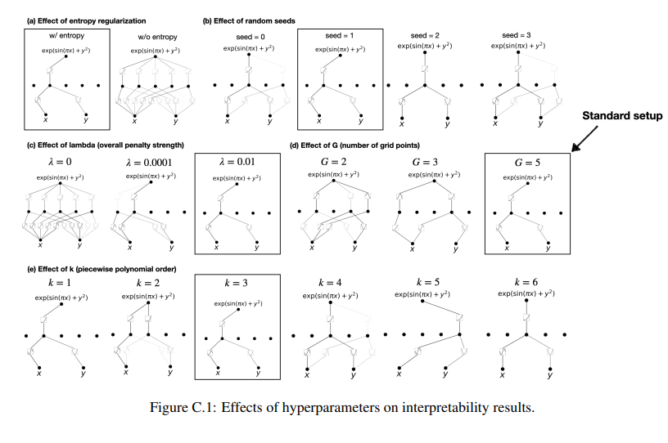
Dependance on Hyperparameter
Notes:
Symbolic representation

Slide 31
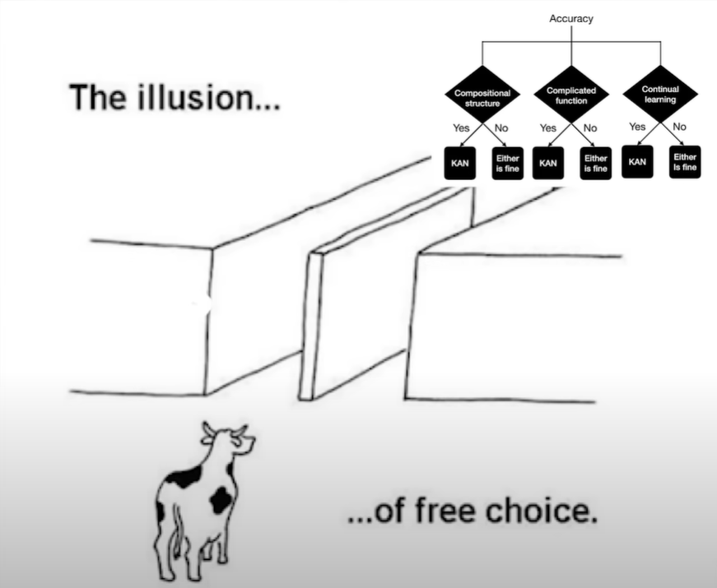
How to Use?
Pykan is an open-source package!
Notes:
Symbolic representation

Slide 32
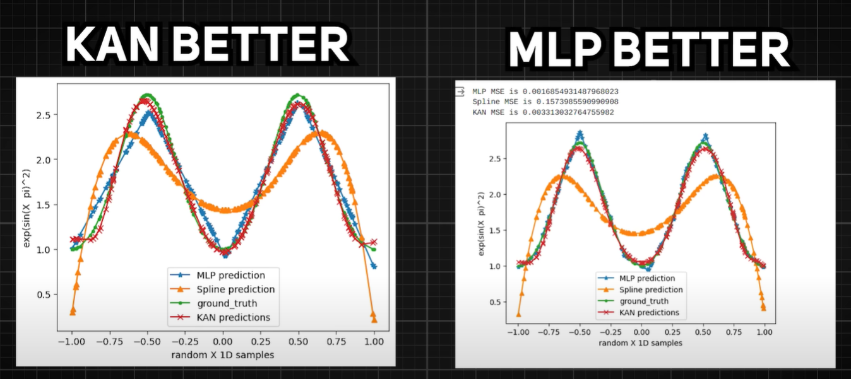
Community Critique
@bozavlado and @milos_ai on X
Notes:
Symbolic representation

Slide 33
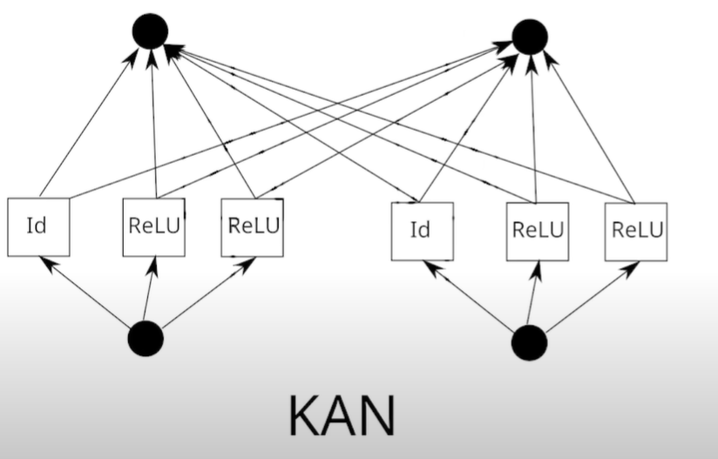
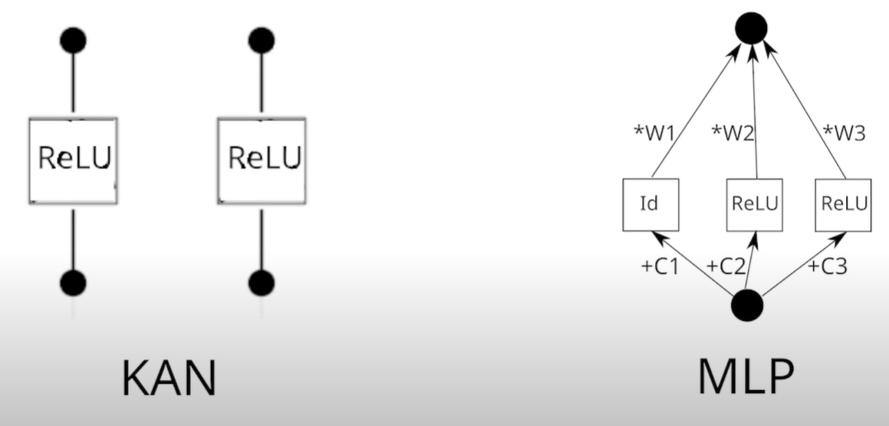
UFA
Universal Function Approximator:
Describes something that can approx. any functions by only changing the weights within a neural network
Notes:
Symbolic representation

Slide 34
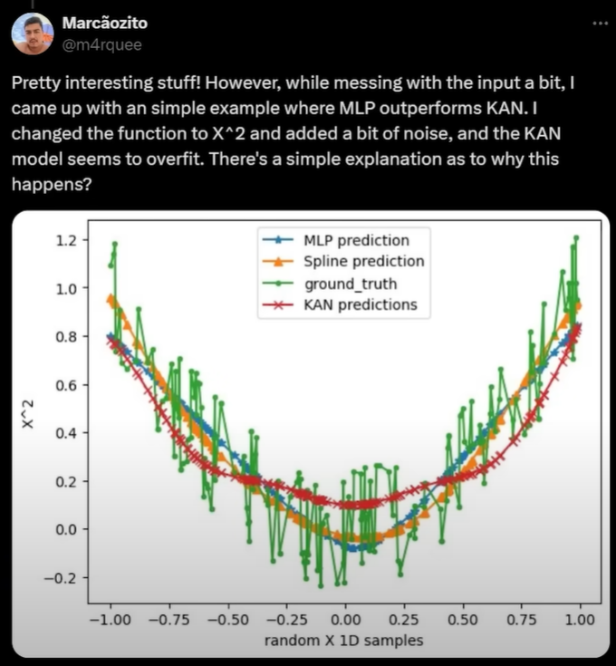
Universal Function Approximator
Notes:
Symbolic representation

Slide 35
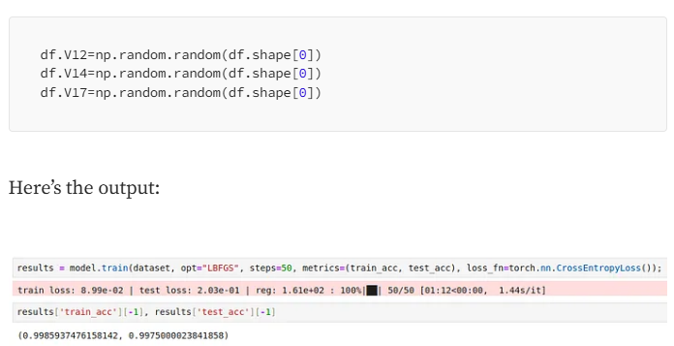
Fitting Random Noise
Source: https://medium.com/@rubenszimbres/kolmogorov-arnold-networks-a-critique-2b37fea2112e
Notes:
Symbolic representation

Slide 36
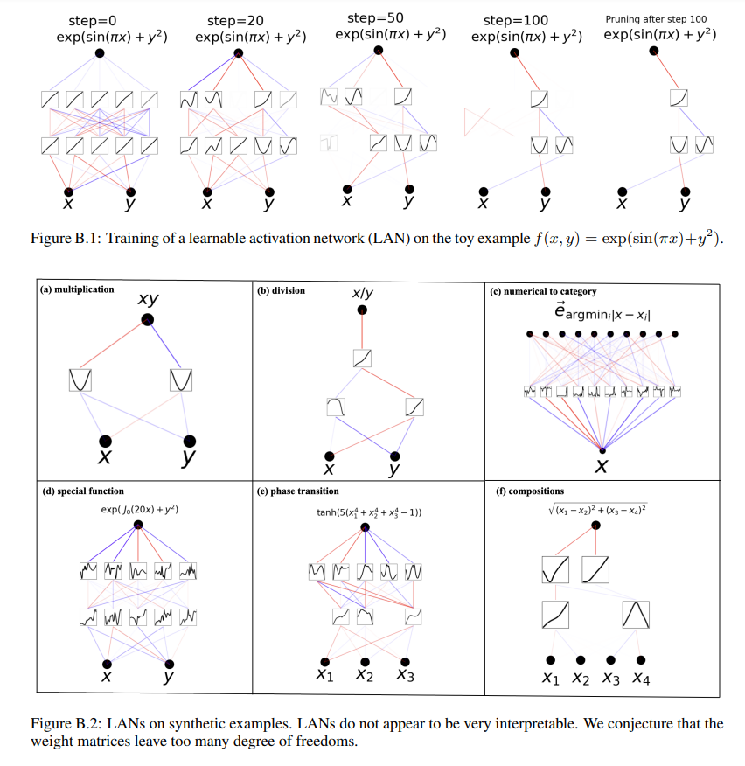
Learnable Activation Functions
Notes:
Symbolic representation

Slide 37
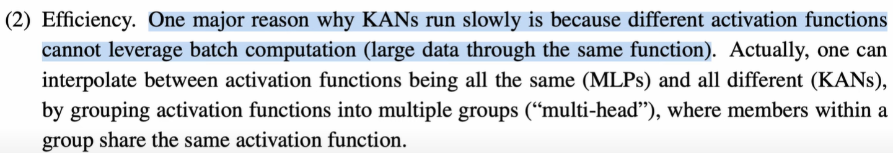
Summary
KANs get the best of MLPs and Splines
Splines:
Great for low dimensional data
Local Control good for continual learning
Able to make the model sparser or coarser
Internal degrees of freedom
MLPs
Backpropagation
Great for compositional
Increase layers/width to add complexity
External Degrees of Freedom
Advantages:
Accuracy at low dimensions
Catastrophic (un)forgetting
Symbolic regression/PDEs
Expressibility
Challenges:
Slow to train, not GPU-efficient
Scalability
Lack of real-world testing
Notes:
Symbolic representation

Slide 38
Discussion

Slide 39
Thank you!

Slide 40
Appendix

